Slide 1
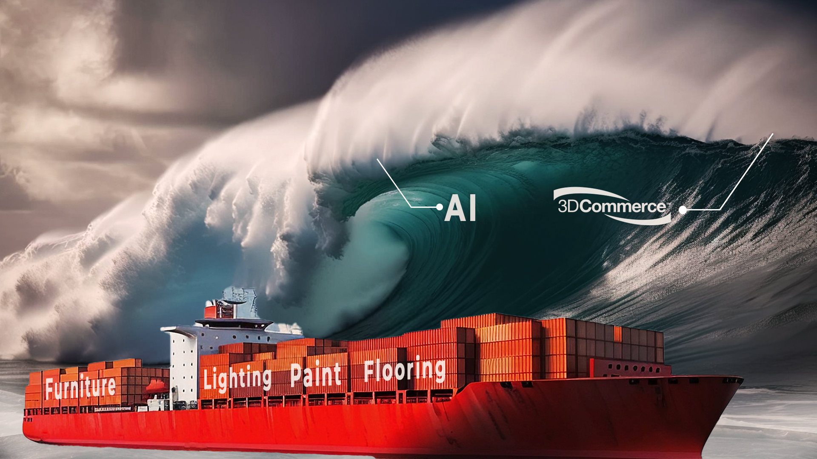
Powerful Tsunami’s ?
Tsunamis
Risk or Opportunity ?

Slide 2
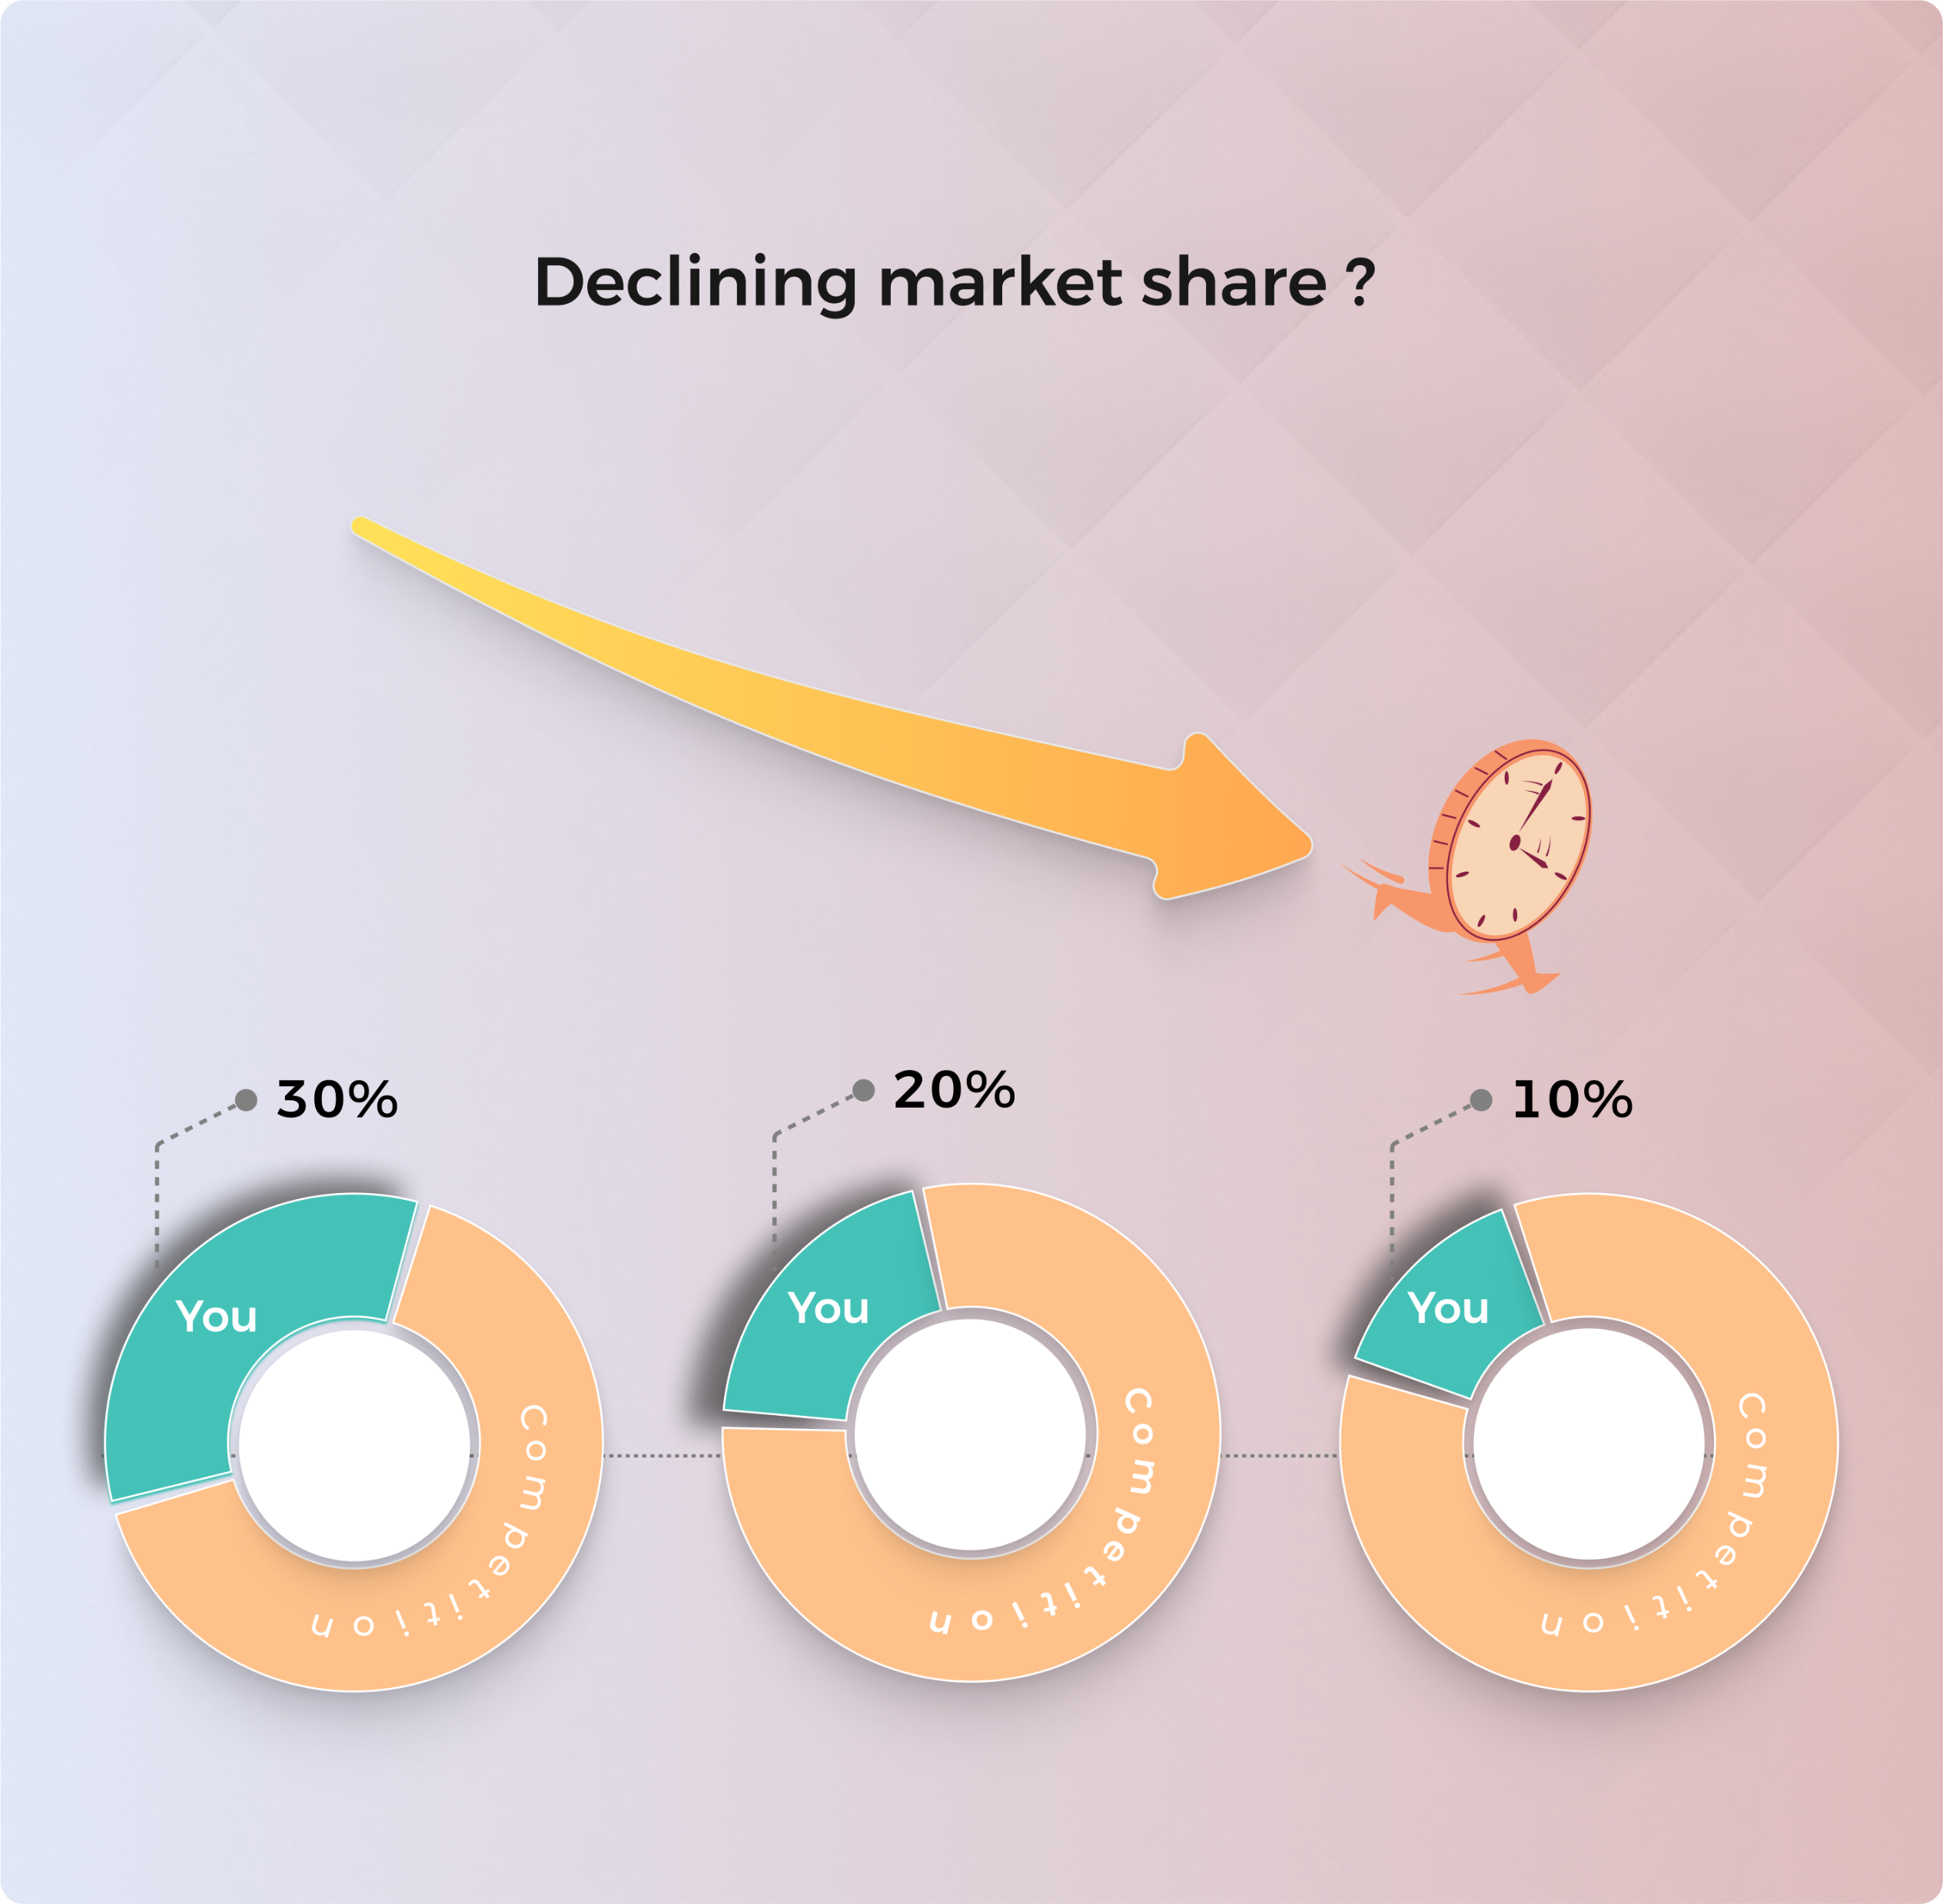
Competitors
Adopting
3DCommerce ?

Slide 3

Call
VisCommerce

Slide 4

Showcase & Sell

Slide 5
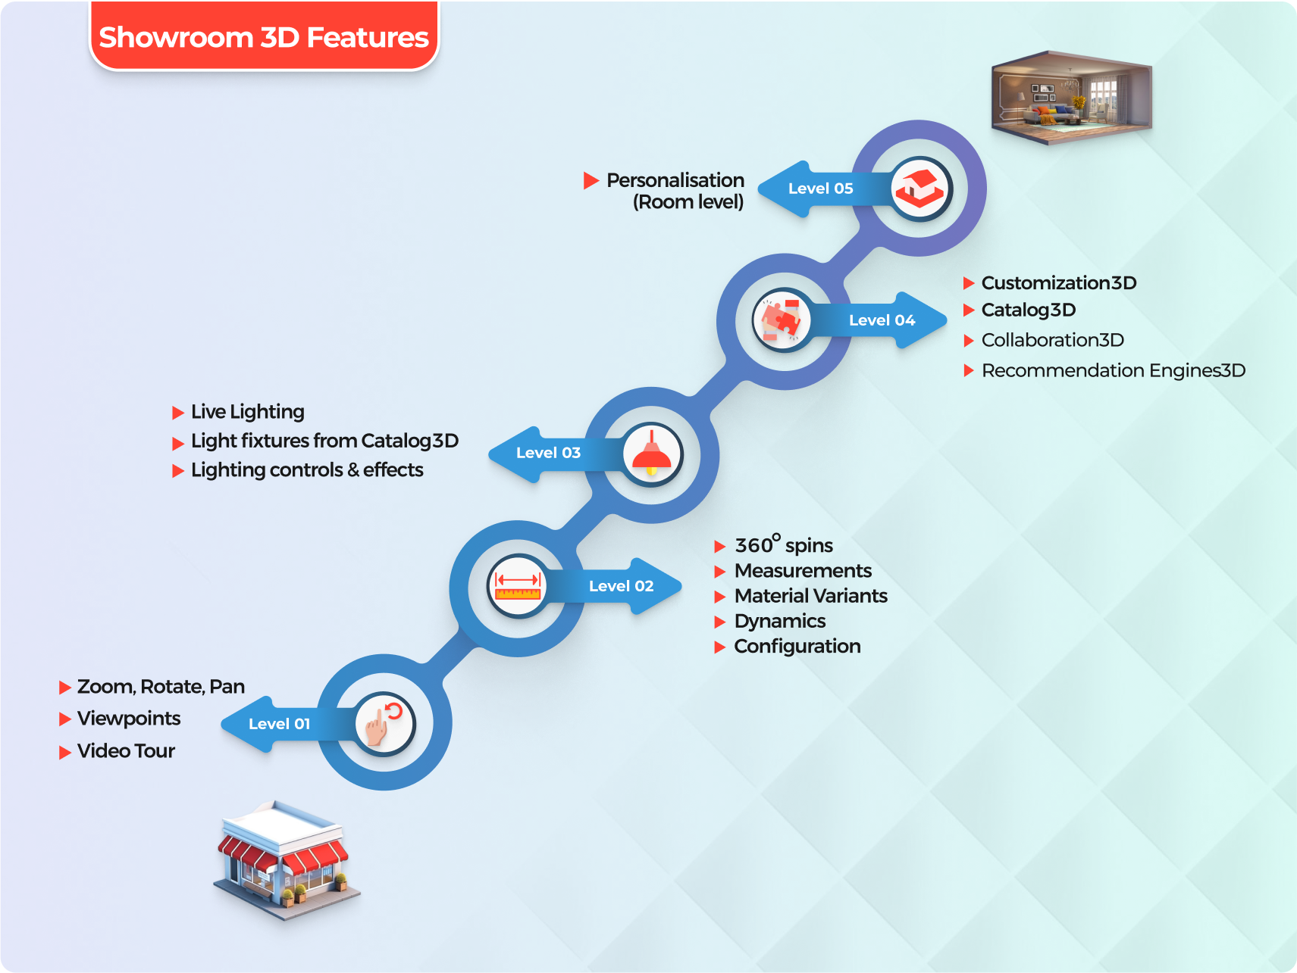
Thrill
Customers

Slide 6

Standing
On
Shoulders
Of
Industry Giants

Slide 7


